Slide 1
ToDo
Analyze the reason why fuzzing stability is too low for some programs
Does the reason is general or specific for each target program?

Slide 2
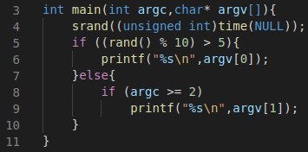
AFL++’s Stability
(# of found edges - # of edges variable) / # of found edges
$ ex aa
(random number >5)
$ ex aa
(random number <=5)
ex.c
edges | hit count
3→5 | 1
5→6 | 1
5→8 | 0
8→9 | 0
8→10 | 0
edges | hit count
3→5 | 2
5→6 | 1
5→8 | 1
8→9 | 1
8→10 | 0
edges
found
edges
variable
Unstable due to the randomness
Stability = (4-3)/4=25%

Slide 3
Analysis for Reasons of Low Stability
Edge IDs and
corresponding functions
Extract
edge IDs
Target program
Extract functions
of var. edges
Functions of var. edges
afl-fuzz
with debug mode
Variable (var.) edges
A seed input
Count edge hit
of each function
edge hit count
of run 1
edge hit count
of run 2
…
edge hit count
of run x
Compare!

Slide 4
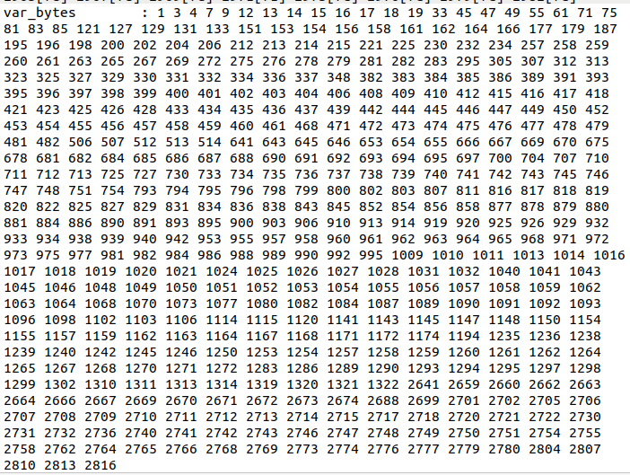
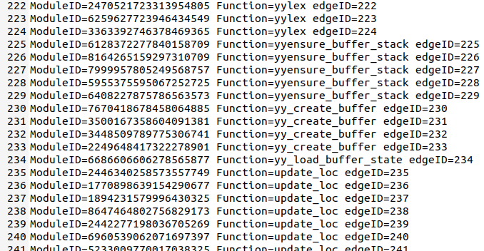
Extract Edge IDs and Var. Edges
Using AFL++ lto mode compiler and afl-fuzz debug mode
Corresponding functions
of each edge
Unique edge ID
Edge IDs of cflow extracted by afl-clang-lto at compile time
Var. edge IDs of cflow extracted by afl-fuzz debug mode
(30 seconds of fuzzing run)

Slide 5
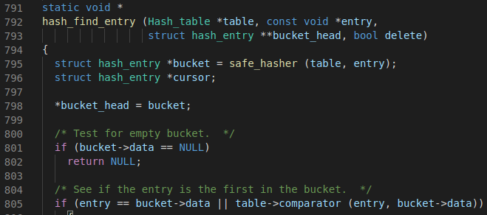
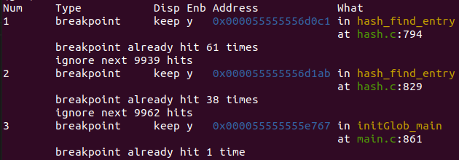

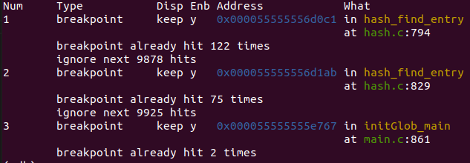
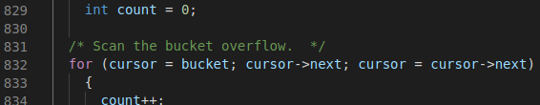
Count Edge Hit of Each Function
Same number of the function call across the two runs
edge hit count of run 1 for the function hash_find_entry
…
122-61=61
75-38=37
edge hit count of run 2 for the function hash_find_entry
Different number of edge hit across the two runs

Slide 6
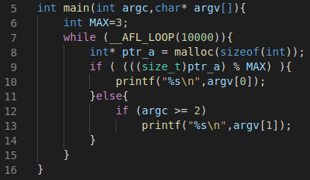
Unstability due to Persistent Mode
Use an outside (out of process) factor which is affected across inputs
e.g., file system access, system call
$ ex aa
$ ex aa
ex.c
edges | hit count
8→9 | 1
9→10 | 0
9→12 | 1
12→13 | 1
12→14 | 0
edges | hit count
8→9 | 2
9→10 | 1
9→12 | 1
12→13 | 1
12→14 | 0
edges
found
edges
variable
Unstable due
to system call
heap
heap
0x000F
0x000B
0x0007
0x0003
0x000F
0x000B
0x0007
0x0003
ptr_a
ptr_a

Slide 7
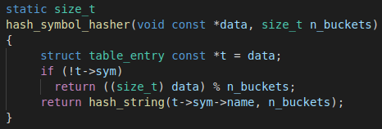
One Reason for the Low Stability of Fuzzing cflow
Hash function that uses memory address as key
Unstable, but correct
Use memory address (which may vary across inputs) of a pointer variable data as the key for hash

Slide 8
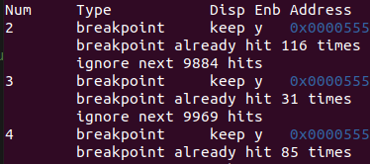
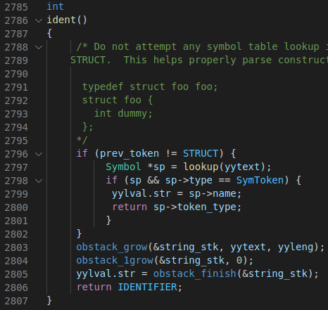
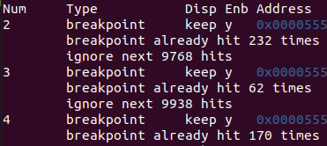
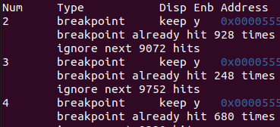
There may be More Reasons of Low Stability, but
Difficulty on finding the reasons
Some variable edges occur after many side effects of many fuzzing inputs
and hard to catch the time it occur.
Run 1
b2
b3
232=116*2
Run 2
62=31*2
b4
170=85*2
The function ident that includes var. edges
…
No found var. edges
across eight runs
928=116*8
Run 8
248=31*8
680=85*8

Slide 9
Next ToDo
Analyze the reason why fuzzing stability is too low for some programs
Does the reason is general or specific for each target program?
Analyze the reasons of instability of cflow and bison
NOTE: after exhaustive global var. reinitialization, persistent mode for bison still fails for all seed inputs
Make 100% stability of binutils/nm and exiv2

